Slide 1
Fogarty for the New Administrator
Kirsten Leysieffer
Thursday, October 25, 2012
Title

Slide 2
Overview
History, Mission & Vision of FIC
Role of the FIC Administrator
Why have FIC Administrator Meetings?

Slide 3
Fogarty International Center History
On July 1, 1968 President Lyndon Johnson issued an Executive Order establishing the John E. Fogarty International Center for Advanced Study in the Health Sciences at the National Institutes of Health.
In the 44 years since, support for Fogarty's international research and research training programs has grown from its first year budget of $500,000 to its current level over $69 million.
The Center's research, training, and capacity-building enterprise extends to over 400 research and training projects involving more than 100 U.S. Universities

Slide 4
NIH Fogarty International Center
Mission
The Fogarty International Center is dedicated to advancing the mission of the National Institutes of Health by supporting and facilitating global health research conducted by U.S. and international investigators, building partnerships between health research institutions in the U.S. and abroad, and training the next generation of scientists to address global health needs.

Slide 5
NIH Fogarty International Center
Vision
The Fogarty International Center’s vision is a world in which the frontiers of health research extend across the globe and advances in science are implemented to reduce the burden of disease, promote health, and extend longevity for all people.

Slide 6
AITRP Founded in 1988
One of a new generation of research training programs to provide training for scientists from institutions in low- and middle-income countries to strengthen HIV-related research and public health capacities at their institutions
Other models that followed included the GID, the ICOHRTA and ICOHRTA AIDS/TB to name a few

Slide 7
Innovative, Adaptable & Flexible
These principles which inspire us and lead to the success of the programs are the same ones that make administration such a challenge.
Working with and around the bureaucracy becomes the challenge.

Slide 8
Strategies for coping with Bureaucracy
Develop contacts
Be responsive and responsible
Maintain your reputation
Play the “global” card
Foster creativity and flexibility in your office and institution
Be persistent

Slide 9
Administrator’s Role
University Admissions Officer / Advisor
Travel Agent
Cultural Ambassador
Immigration Advisor
Relocation Specialist
Chauffer
Grants Manager
Financial Analyst
Grant Writer & Forms Guru
Academic Advisor
IRB Consultant
CareerTrac Expert
PI’s Right Hand
What else??

Slide 10
Sometimes we feel like the hub…
Administrator
Trainees & Potential Trainees
NIH
Institution & Foreign Sites
PI

Slide 11
Working with potential Trainees
Fielding questions – eligibility, application process
Type of training – short/medium/long term
Trainee selection – applicant evaluation, mentor identified (here, in home country)
Long terms plans for applicant – helps to generate the re-entry plan before they arrive

Slide 12
Preparing for Trainee Arrival
Letter of acceptance – includes training plan, stipend, travel, visa process, conditions of employment, intent to return
Work with international center to get appropriate visa – or work with in-country institutions if sending US trainees abroad to get the appropriate visa paperwork started
Prepare trainee for embassy visit – what paperwork to take along: DS2019, valid passport, support letters, SEVIS Receipt, other documents which can support intent to return to home country.

Slide 13
Preparing for Trainee Arrival
Airline tickets
Housing
Furniture
Money to live on until first paycheck
Meeting at airport
Orientation

Slide 14
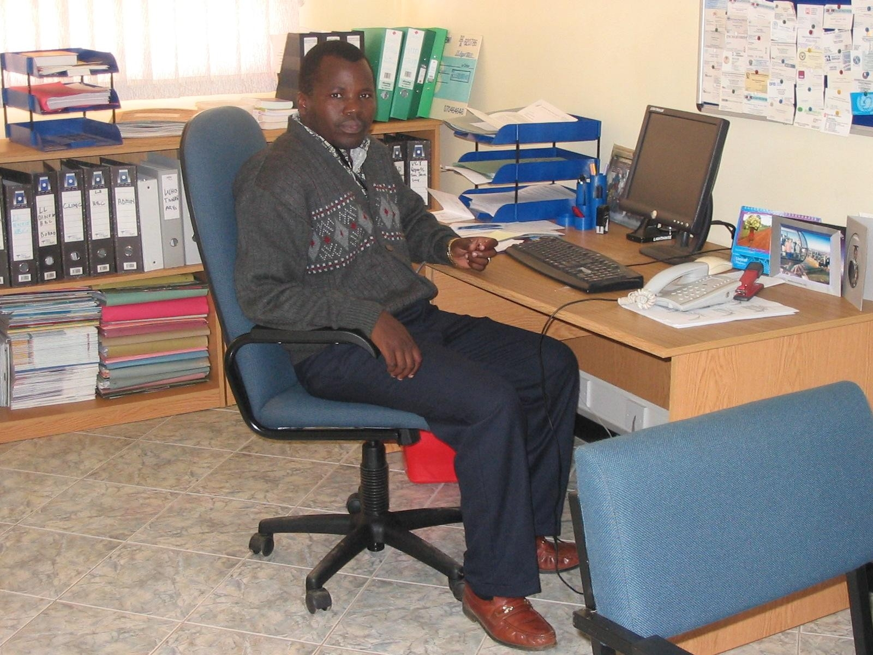
After Training Ends
Facilitate the trip home
Stay in touch and celebrate success and career achievements with trainees
Sam Phiri, PhD
UNC-AITRP PhD
Director, The Lighthouse
Leading nationwide roll-out of HIV therapy in Malawi

Slide 15
Useful links – Travel & Immigration
State Department - Foreign Per Diem rates: http://aoprals.state.gov/content.asp?content_id=184&menu_id=78
State Department - J-1 Visa: http://j1visa.state.gov/
SEVIS - Immigration & Customs Enforcement: http://www.ice.gov/sevis/

Slide 16
While the trainee is here (or there)
Set up payment for tuition and stipends
Assist with IRB as needed and connections with research team
Keep in touch
Cope with surprises and emergencies
Semper Gumby!
Be Flexible

Slide 17
Concerns
Provide trainees with written terms and conditions of the award
Keep a record of decisions made for internal policies and procedures (helps maintain consistency across trainees)
Remind trainees that we are stewards of federal funds and answerable to the NIH/FIC and the federal government, therefore we are required to follow the regulations (also must follow institution and state policies)
Be consistent and fair
Set comfortable boundaries for yourself
Try not to take things personally
Remember Culture Shock

Slide 18
General Logistical and Administrative Issues
Maintain trainees in CareerTrac
Organize PHS 2590 Annually
Compile trainee reports
Generate (or assist with) budget
Coordinate competitive renewals, supplements and new grant applications
Assist trainees as they apply for independent grant support

Slide 19
Important FIC Links
Fogarty International Center: http://www.fic.nih.gov/
Staff Directory: http://www.fic.nih.gov/About/Staff/Pages/default.aspx

