Slide 1
In-Country Capacity Building through Fogarty: A Grant Proposal Writing Case Study
Nathan Meier
Director of Research Strategy
Office of Research and Economic Development
University of Nebraska-Lincoln
November 1, 2012

Slide 2
Agenda
About me
About the workshop
Getting ready
Workshop goals
Workshop content
Group activity
Workshop outcome
Takeaways
Questions/Discussion

Slide 3
About Me
Maintain broad knowledge of proposal preparation requirements across grant-making entities
Interact with faculty, staff, and administrators regarding proposal conceptualization and composition
Compose, organize, and refine information included in grant proposals
Facilitate collaboration among faculty, and administrators for multi-institutional, interdisciplinary projects
Clients have won more than $190 million in grants from DoD, DoE, NIH, NIST, NSF, USDA, Gates Foundation, etc.

Slide 4
About the Workshop
1.5-day didactic session covering theoretical and practical aspects of proposal writing
Focus largely on NIH applications (but demonstrated broader applicability)
University of Zambia faculty, administrators, and graduate students comprised the target audience
Used a blended instructional approach: lecture, hands-on and small group work, and presentations

Slide 5
Getting Ready
Audience: Who is the target audience? How many individuals will participate?
Focus: Targeted toward NIH or proposal writing in general?
Is there anything I should particularly emphasize?
Format: Will I be able to use PowerPoint? Will we be able to prepare handouts in country?
Content: Are there any cultural issues that should influence the workshop design/content? English is Zambia’s primary language, correct?

Slide 6
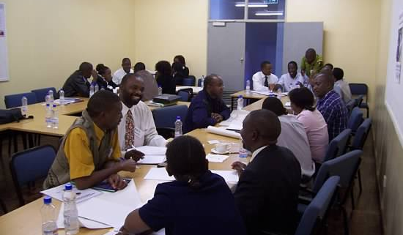
Workshop Goals
Two-fold workshop goal was to help participants:
write effective grant proposals by using time-tested strategies to identify new opportunities and solve complex problems
develop plans for action, organize their ideas, improve the clarity of their writing, and persuade their readers to say yes

Slide 7
Workshop Content
Overview of Proposal Writing
Identifying Problems and Opportunities
Preparing a Grant Proposal
Specific Aims, Plan of Work, Future Directions, Timeline, Significance, Literature Cited, Preliminary Work, Abstract/Summary
Characteristics of a Successful Proposal Writer
Realities of Pursuing Grant Support
Tips on How to Up the Odds of Success

Slide 8
Workshop Content
Anticipating audience (reviewer, sponsor) expectations is key

Slide 9
Workshop Content
The proposal genre is not a formula into which writers plug and chug content.
Many proposals do not follow this pattern in this order.
In most cases, not all four areas of the proposal genre require a separate section of the proposal.
However, if a proposal accounts for these four areas, it typically will have addressed readers’ expectations.
Always be sure to follow the proposal preparation requirements specified by the request for proposals (RFP)!

Slide 10
Group Activity
Working in groups, identify a problem needing a solution
Identify a goal that a successful solution would need to meet
Map out a plan to solve the problem:
What needs to be done to achieve the identified goal?
What resources are needed to complete these activities (personnel, facilities, equipment, etc.)?
Leverage this information to design a proposal

Slide 11
Group Activity
Solution Goal
Activity or Study #1 Specific Aim #1
Activity or Study #2 Specific Aim #2
Activity or Study #3 Specific Aim #3
Brainstorm potential funding sources

Slide 12
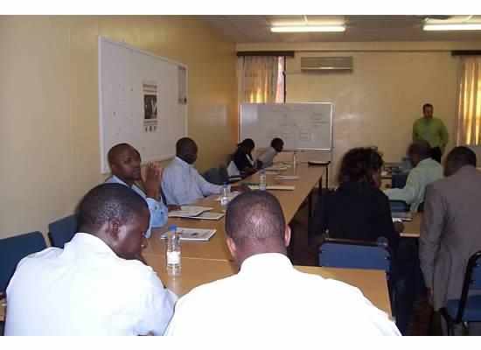
Group Activity
For each of Specific Aim, answer the following
questions:
What specifically does the study or activity involve?
Why is the work necessary to achieve the project goal?
How will the work be conducted?
Who will conduct the work?
When will the work occur?
Where will the work occur?

Slide 13
Workshop Outcome
Proposal framework and information to move ahead
Sense of resource and teaming requirements
Viable proposal concepts:
Program to curb the maternal mortality rate in Zambia
Education and training plan to reduce postoperative infection
Awareness and prevention campaign focused on youth rape
Offer to receive feedback on proposal drafts or answer questions

Slide 14
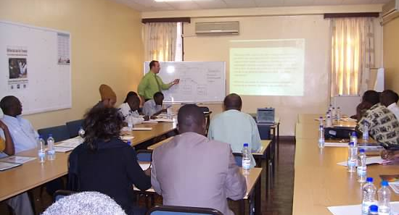
Takeaways
Should have:
scheduled and implemented mentored writing plans (including expert review)
extended the focus or scheduled a separate workshop to cover pre- and post-award issues (e.g., budget development)
conducted a follow-on session covering more advanced topics
Always remember to:
never assume anything
remain flexible
engage stakeholders

Slide 15
Questions?
Thank you!
Nathan Meier
301 Canfield Administration Building
Office of Research and Economic Development
University of Nebraska-Lincoln
Lincoln, NE 68588-0433
Phone: 402.472.3902
Email: nlm@unl.edu
Web: research.unl.edu

